Slide 1
Site reliability engineering
Javaria Abid

Slide 2
Table of contents
Introduction
Reliability
Reliability Engineering
SRE
Background
SRE Tasks
SRE vs DevOps
SRE Tools

Slide 3
INSTRUCTOR ITRODUCTION
Lecturer Javaria Abid
MSIT (NUST ISB)
BSCS (International Islamic University ISB)

Slide 4
Course
Assignment | 15% | Quiz | 15%
Lab | 0% | Project / Presentation | 15%
Mid Term | 20% | Final | 30%
Other 1 | 0% | Other 2 | 0%

Slide 5
Reliability Definition
Generally defined as the ability of a product to perform, as expected, over certain time.
Formally defined as the probability that an item, a product, piece of equipment, or system will perform its intended function for a stated period of time under specified operating conditions.
In the simplest sense, reliability means how long an item (such as a machine) will perform its intended function without a breakdown.
Reliability is performance over time, probability that something will work when you want it to.

Slide 6
The Reliability Definition Has Important Elements:
Probability (A value between 0 and 1, number of times that an event occurs (success) divided by total number trials)
e.g. probability of 0.91 means that 91 of 100 items will still be working at stated time under stated conditions Performance (Some criteria to define when and how product fails, which also describes what is considered to be satisfactory system Time (system working until time (t), used to predict probability of an item surviving without failure for a designated period of time)
Operating conditions These describe the operating conditions (environmental factors, humidity, vibration, shock, temperature cycle, operational profile, etc.) that correspond to the stated product life.

Slide 7
WHY RELIABILITY ENGINEERING?
Reliability, Availability, Maintainability, Safety and Quality are what the Customer says they are, not what the Engineers or the Designers say they are.
Companies who control the Reliability of their products can only survive in the business in future as today's consumer is more “intelligent” and product aware.
Liability for unreliable products can be very high.
Complexity of products is ever increasing and thus challenge to Reliability Engineering is also increasing.
Products are being advertised by their Reliability Ratings.
“PRIDE = Put Reliability In Daily Efforts”

Slide 8
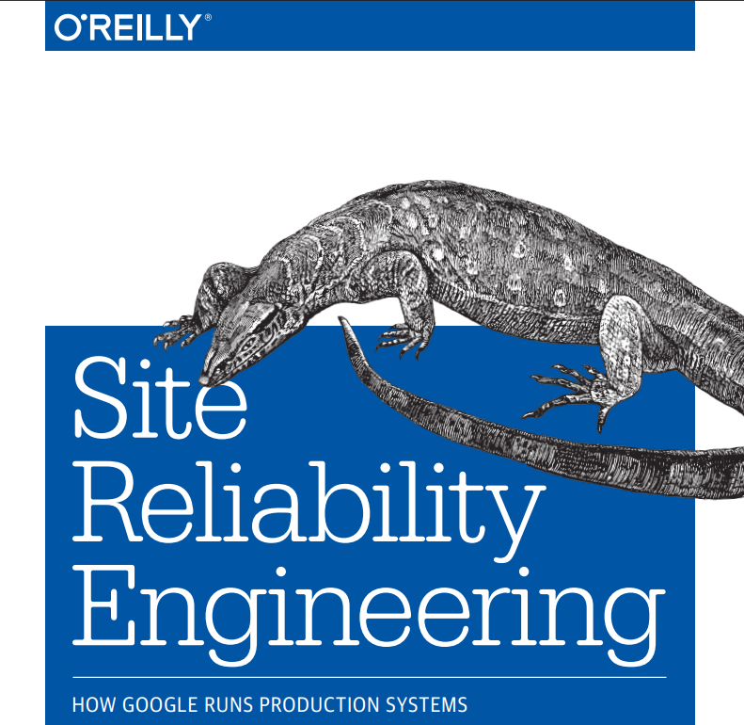
BOOK

Slide 9
What Is SRE?
An approach to operations which uses software as the primary tool for managing systems.
Site Reliability Engineering (SRE) is the outcome of combining IT operations responsibilities with software development.
With SRE there is an inherent expectation of responsibility for meeting the service-level objectives (SLOs) set for the service they manage and the service-level agreements (SLAs) we promise in our contracts.

Slide 10
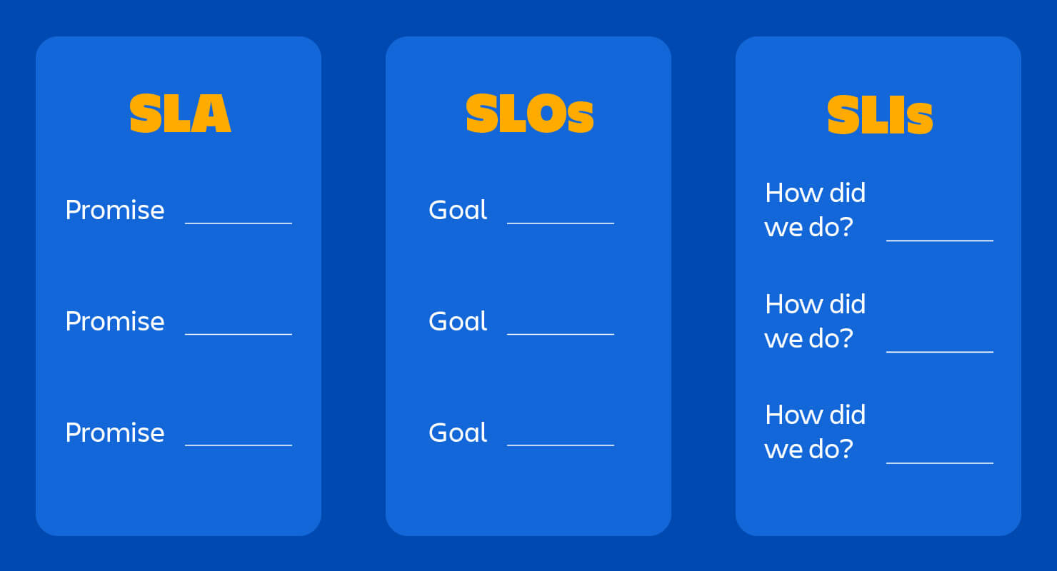

Slide 11
SRE
SLOs set targets for reliability that are frequently referred to as error budgets.
Data is gathered while the system is operating and compiled as service-level indicators (SLIs) to help guide decision making by SREs about what parts of the system need to be prioritized for enhancement.
To help with this, engineers automate anything they can rather than repeat tasks. This automation creates more engineer time by eliminating toil, time that can be spent on making the site more and more reliable.
Notes:
Applying this automation expectation to operations tasks leaves software developers and system administrators who are becoming site reliability engineers with the task of learning how to deal with complex issues that may be outside of their previous experience. They are now expected to handle issues like latency, performance, high availability (HA), complex distributed production systems, system monitoring, emergency response and disaster recovery, and even change management with only the amount of human interaction that is absolutely necessary. This leads to greater and greater efficiency.

Slide 12
SRE
The focus on reliability is the main factor separating DevOps and Site Reliability Engineering, not automation.
An SRE team is software development, systems administration, and IT operations all merged together. Any given member may be strongest as a sysadmin, a dev, or a dba, but no member does only one thing. They all work together toward a common goal without the traditional walls obstructing communication and cadence.

Slide 13
How Did Site Reliability Engineering Begin?
“Site Reliability Engineer" was invented by Ben Treynor, a Vice President of Engineering at Google who is ultimately responsible for thousands of software engineers. His LinkedIn profile says,
If Google ever stops working, it’s my fault.

Slide 14
How Did Site Reliability Engineering Begin?
“It's what happens when you ask a software engineer to design an operations function.”
Ben Treynor Sloss, VP Engineering, Founder of Google SRE

Slide 15
Cont..
In addition to combining software engineering and operations roles, the big change was a perspective shift. The move from reactive firefighting when problems arise to proactive hardening of infrastructure is a big deal. It requires more focused attention up front, but ultimately saves SRE worker time and company money by preventing potential failures.
It is this sort of perspective shift that led to the creation of Chaos Engineering as a practice embraced by SREs and DevOps practitioners. Anyone wanting to prove that the mitigation schemes and preventative actions implemented actually works suddenly had tools at hand to do so.

Slide 16
What Are The Foundations And Benefits Of Site Reliability Engineering?
Our Systems Are Complicated
Automation Helps Us Manage Complexity
Much of the administration of large systems today involves mundane, repetitive tasks.
No engineer wants to do the same thing over and over and over. We love solving problems and coming up with useful solutions
We love it even more when it relieves us of tasks we don't enjoy and gives us more time for fun and beneficial work.
We love automation even more when it is reliable and makes our systems more resilient to high impact events.. When our systems monitor, alert, and even react before this becomes a problem, everyone benefits
Notes:
The number of moving parts and discrete, functional units within our architectures are vast and impossible for any one person to completely understand at any given moment. Plus, our systems are constantly changing. New capacity is being added. Failover systems. Load balancing. Canary deployments. Old containers that are no longer needed are constantly being removed.
Where we used to design a system on paper, drawing out system diagrams and system architectures, today our systems have changed before the ink is dry with any attempt to do so. They can at best be considered approximations
Repetition quickly becomes drudgery and leads to job hunting in search of a new and interesting challenge
We all appreciate it when we don't have to put out a metaphorical fire that resulted from a greater number of concurrent users than is typical

Slide 17
Who Benefits From Site Reliability Engineers?
Any
Company large enough to need more than a small handful of people to manage their systems will benefit from Site Reliability Engineering.
Of us with systems large enough or vital enough to require 99% availability or greater will benefit. If uptime matters, well-implemented SRE will help you improve it.
Companies with large numbers of users, whether internal to the company or external customers
Notes:
many companies are moving much of their processing and computing power to cloud-based services. Some have moved everything to the cloud while others have a reason to use a hybrid architecture that keeps sensitive data like personally identifiable information (PII) or company financials in house while moving other processing to the cloud. Still others have an internally owned data center using virtualization or an internal cloud.

Slide 18
What Do Site Reliability Engineers Do On A Daily Basis?
Site Reliability Engineers start by looking at the system, then taking the easiest and most mundane tasks and automating them. This frees up more time for coding new features and preparing for potential problems.
Site Reliability Engineers tend to come from either a software development background or a systems or operations background, writing code and managing the system.
Well-suited to both know what would be useful to automate and also to write the code that does the automation.

Slide 19
Disaster Mitigation
plans for how to deal with bad things when bad things happen.
Both senior and junior SREs worth together to try to automate as many of the discovered mitigation tasks as they can:
spinning up extra database servers when response times are slow, rerouting traffic around overloaded app servers when CPU usage or networking capacity is getting a little too close to capacity, and so on.

Slide 20
Configure And Use Monitoring For Observability
Monitoring requires a knowledge of the system and what data would be meaningful and useful.
It also requires good tooling and taking the time to learn how to use it well.
Monitor "everything," but the result of doing that is a firehose blast of information that is overwhelming and quickly becomes ignored.
Metrics tell us what we need to know about the system, preferably well before user-impacting problems occur and far, far before downtime happens
We can't catch everything, but doing this scientifically helps us catch as much as we know we need to catch while preventing us from an overload of noise and distraction.

Slide 21
Site And Software Maintenance
To be secure and up to date, a system must be maintained. It is not acceptable to have outdated software versions or old configurations when you are aiming for quality, stability, and safety.
SREs spend some of their time making sure software is properly updated in a timely manner. They may automate things like version checks, expiration dates for things like security certificates, and dependency needs.

Slide 22
Incident Management And Incident Repair
One of the primary tasks for the SRE is keeping a site up and running, and when it stops running because something failed, getting it back up and running as quickly as possible.
An incident happens. An alert is sent out. Pager duty
Notes:
An incident happens. An alert is sent out. Pager duty. The SRE on call stops whatever she is doing and starts working to find out what the problem is. Everyone in the on-call team gathers, perhaps in person or maybe using a video or audio conference call. Information is gathered and shared. Incident playbooks and runbooks are pulled out and used to prioritize what to look at and for to try to get things working again. If they fail to help, which sometimes happens, ideas and potential fixes are discussed. Responsibilities are spread across team members. Everyone works together to do whatever research and tasks are required to get the system back up, running, and available

Slide 23
Prevent Data Loss
Data is the most important thing we have in our systems. Every component exists to do something with or for data. Input (receive) data, store data, process data, transform data, use data, output data, the list goes on.
Some data is proprietary(patent/ownership). Some is sensitive. Many types of data can only be handled according to strict regulatory standards.

Slide 24
Prevent Recurrence Of Past Problems
SREs look at problem events from the past and try to prevent them from recurring. This is where events like blame-free retrospectives are incredibly valuable. Talking through a problem issue by issue, noting what happened and how, without making anyone the scapegoat will elicit useful ideas and participation in keeping the problem from happening again

Slide 25
Incident Analysis
Analyze an incident while it is in progress, looking for how to repair and recover.

Slide 26
Tenets of sre
In general, an SRE team is responsible for the availability, latency, performance, efficiency, change management, monitoring, emergency response, and capacity planning of their service(s)

Slide 27
What Skills Do I Need to Become a Site Reliability Engineer?
A top notch Site Reliability Engineer
Natural though process in prioritization.
Able to sift through information and discern what is important and what is not. excellent interpersonal communication skills.
They will also have a skill set including some level of familiarity with:
Git and hosts like GitHub and/or GitLab
Vim
Linux fundamentals like package management, user account management, and directory and file permissions
Basic server software management such as for Apache
SSH
Shell scripting, such as with Bash
Programming with languages like Python and perhaps Go and Rust
Automation
Networking
Monitoring, logging, and observability
Testing, including the ability to write both unit tests and tests for use in CI
Databases, both relational like MySQL and Postgres as well at least passing familiarity with newer NoSQL/NewSQL options like Cassandra, MongoDB, and Neo4j
Notes:
"Vim" is technically an abbreviation for "Vi IMproved.“ (because this editor is widely available on pretty much any server you are likely to encounter)
SSH stands for "Secure Shell." It is a cryptographic network protocol that provides a secure way to access and manage remote devices over unsecured networks

Slide 28
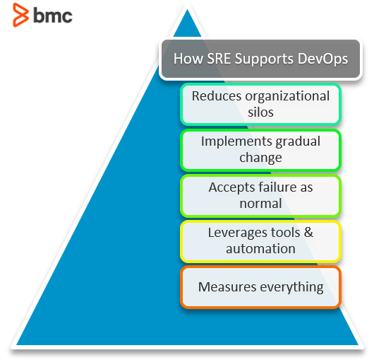
SRE vs DevOps
DevOps and site reliability engineering (SRE) are two approaches that enhance the product release cycle through enhanced collaboration, automation, and monitoring.
Both approaches utilize automation and collaboration to help teams build resilient and reliable software but there are fundamental differences in what these approaches offer and how they operate.
Notes:
SRE IMPLEMENTS DEVOPS INTERFACE

Slide 29
SRE VS DEVOPS
DevOps is a broad set of principles about whole-lifecycle collaboration between operations and product development
SRE is a job role, a set of practices and some beliefs that animate those practices.
If DevOps Is a philosophy and an approach to working,
SRE implements some of the philosophy that DevOps describes,
So, in a way, class SRE implements interface DevOps.

Slide 30
SRE vs DevOps
DevOps focuses more on a cultural and philosophical shift, and SRE is more pragmatic and practical.
This highlights various differences in how the concepts operate, including:
Essence. SRE to create a set of practices and metrics that allow for improved collaboration and service delivery. DevOps, on the other hand, is the collection of philosophies that enable the mindset of culture and collaboration between siloed teams.
Goal. Both SRE and DevOps aim to bridge the gap between development and operations, though SRE involves prescriptive ways of achieving reliability, while DevOps works as a template that guides collaboration.
Focus. Site reliability engineering mainly focuses on enhancing system availability and reliability while DevOps focuses on speed of development and delivery while enforcing continuity.
Team structure. An SRE team is composed of site reliability engineers who have a background in both operations and development. DevOps teams include a variety of roles, including QA experts, developers, engineers, SREs and many others.
Notes:
"Siloed" refers to the situation where information, resources, or activities within an organization are compartmentalized or isolated from each other.

Slide 31
The Site Reliability Engineer Role
An SRE is tasked with ensuring seamless collaboration between IT operations and development teams through the enhancement and automation of routine processes. Some core responsibilities of an SRE include:
Developing, configuring, and deploying software to be used by operations teams
Handling support escalation issues
Conducting and reporting on incident reviews
Developing system documentation
Change management
Determining and validating new features and updates

Slide 32
SRE Tools
SRE teams rely on the automation of routine processes using tools and techniques that standardize operations across the software’s lifecycle. Some tools and technologies that support Site Reliability Engineering include:
Containers package applications in a unified environment across multiple deployment platforms, enabling cloud-native development.
Kubernetes is a popular container orchestrator that can effectively manage containerized applications running on multiple environments.
Cloud platforms allow you to provision scalable, flexible, and reliable applications in highly distributed environments. Popular platforms include Microsoft Azure, Amazon AWS, and Google Cloud.
Project planning & management tools allow you to manage IT operations across distributed teams. Some popular tools include JIRA and Pivotal Tracker.
Source control tools such as Subversion and GitHub erase boundaries between developers and operators, allowing for seamless collaboration and release of application delivery. Source control tools include Subversion and GitHub.

Slide 33
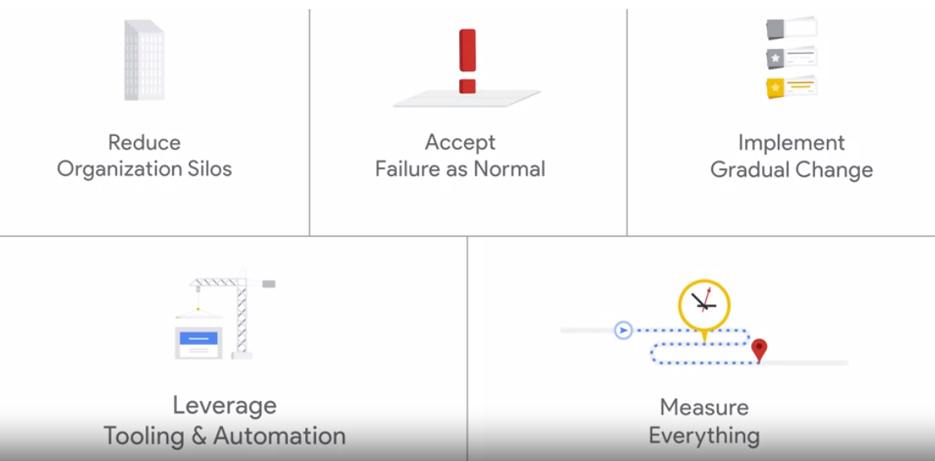
How SRE Supports DevOps Principles & Philosophies
SRE and DevOps are not competing methodologies. That’s because SRE provides a practical approach to solving most DevOps concerns.

Slide 34
Reducing Organizational Silos
DevOps works to ensure that different departments/software teams are not isolated from each other, ensuring they all work towards a common goal.
SRE enables this by enforcing the ownership of projects between teams. With SRE, every team uses the same tools, techniques, and codebase to support:
Uniformity
Seamless collaboration

Slide 35
Implementing Gradual Change
DevOps embraces slow, gradual change to enable constant improvements. SRE supports this by allowing teams to perform small, frequent updates that reduce the impact of changes on application availability and stability.
Additionally, SRE teams use CI/CD tools to perform change management and continuous testing to ensure the successful deployment of code alterations.
Notes:
CI/CD tools, which stand for Continuous Integration and Continuous Delivery/Continuous Deployment, are essential components of modern software development practices. These tools automate various stages of the software delivery process, from code integration and testing to deployment and delivery.

Slide 36
Accepting Failure As Normal
Both SRE and DevOps concepts treat errors and failure as an inevitable occurrence.
While DevOps aims to handle runtime errors and allow teams to learn from them,
SRE enforces error management through Service Level Commitments (SLox) to ensure all failures are handled.
SRE also allows for a risk budget that allows teams to test the limits of failure for reevaluation and innovation.

Slide 37
Leveraging Tools & Automation
Both DevOps and SRE use automation to improve workflows and service delivery.
SRE enables teams to use the same tools and services through flexible application programming interfaces (APIs).
While DevOps promotes the adoption of automation tools, SRE ensures every team member can access the updated automation tools and technologies.

Slide 38
Measure Everything
DevOps and SRE support automation, continuously monitor the developed systems to ensure every process runs as planned.
DevOps gathers metrics through a feedback loop.
SRE enforces measurement by providing SLIs, SLOs, and SLAs to perform measurements.
Since Ops are software-defined, SRE monitors toil and reliability, ensuring consistent service delivery.
Notes:
Toil: hardwork

Slide 39
Summing Up DevOps & SRE
SRE involves the application of software engineering principles to automate and enhance ITOps functions such as:
Disaster response
Capacity planning
Monitoring
On the other hand, a DevOps model enables the rapid delivery of software products through collaboration between development and operations teams.

Slide 40
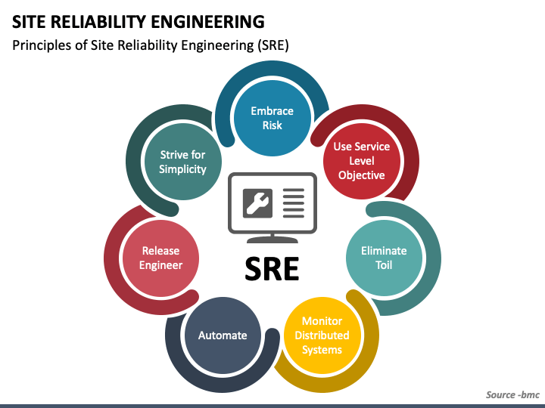
FURTHER MAP
Notes:
https://www.blameless.com/blog/sre-principles

Slide 41
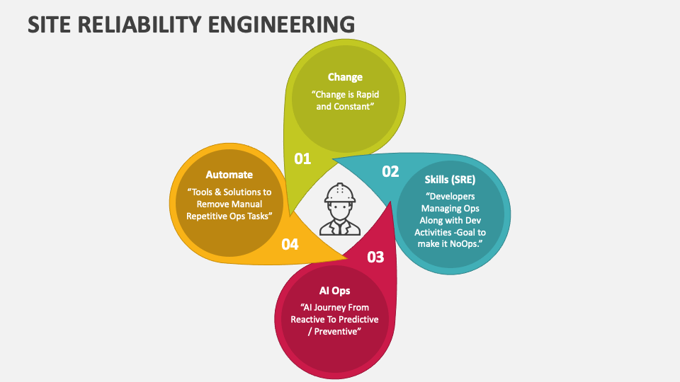
sre

Slide 42
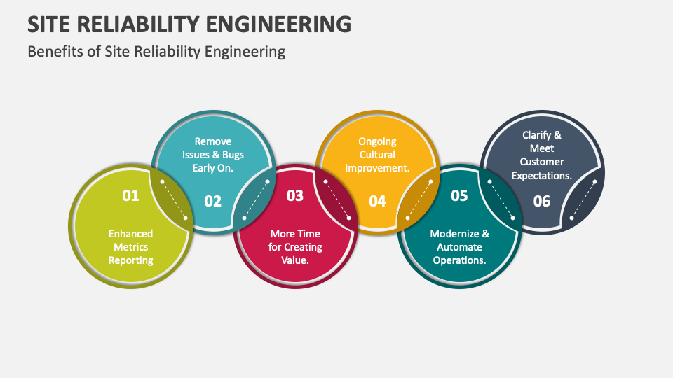
SRE

Slide 43
